Slide 1

IT-C
Data Analysis & Machine Learning Using Python Internship
Team Name : Shift Enter
Project Name : Predicting The Survival Of Titanic Passengers
Group Number : 19
Group Members :
Vibhanshu Jaiswal IT
Manisha Joshi IT

Slide 2

Course Outline
Lesson 1.
Problem Statement
Lesson 2.
Goals & Objective
Lesson 3.
Introduction
Lesson 4.
Motivation
Lesson 5.
Software Required
Lesson 6.
Implementation

Slide 3
Course Outline
Lesson 8.
Importing The Necessary Libraries
Lesson 9.
Preprocessing of Data
Lesson 10.
Data Visualization
Lesson 11.
Machine Learning Algorithms
Lesson 7.
Data Description
Lesson 12.
Result Analysis & Conclusion

Slide 4

Problem Statement:
The Titanic dataset provides observations for each passengers & the survival of outcome. The problem statement entails predicting whether a passenger would survive or not survive given the features such as passenger class, sex, fare, age, number of siblings/spouse aboard, number of parents/children aboard, and others.
In this presentation, I’ve analyzed each of the started features with respect to survival outcome based on the Titanic dataset using Tableau visualization techniques.
This analysis based on data visualization can be a very effective method in feature selection.

Slide 5

Goals & Objective :
The purpose of this project is to understand all those causes/ attributes/ factors on which survival probability of a passenger depends.
The objective of this project was to build a classification model that could successfully determine whether a Titanic passenger lived or died.

Slide 6

Introduction :
The sinking of the RMS Titanic is one of the most infamous shipwrecks in history.
In this challenge, we ask you to complete the analysis of what sorts of people were likely to survive.
In particular, we ask you to apply the tools of machine learning to predict which passengers survived the tragedy.

Slide 7

Motivation :
“Titanic” was the famous tragedy of the maritime history, we all are aware of this fact. My motivation for this project is from the movie Titanic(1997) which led me to choose this objective to know more in deeper about this calamity.
This was also the result of ill planning and preparation of ill planning and preparation of decision making authority(like decrement in the total no. of lifeboats)
The motive is to examine all those aspects due to which that travel result into the terrific tragedy and finding out some fruitful points so that we could apply them and could prevent the occurrence's of such events in future.

Slide 8

Software Required :
1. Analyzing : NumPy, Pandas, Sci-Kit Learn.
2. Visualization : Matplotlib, Seaborn
Library Used
Tools Used
1. Anaconda Navigator - 5.3.0
2. Jupyter Notebook – 6.0.3

Slide 9

Implementation :
Importing the necessary libraries.
Importing the dataset.
Cleaning and analyzing the dataset.
Using random forest for making prediction.

Slide 10
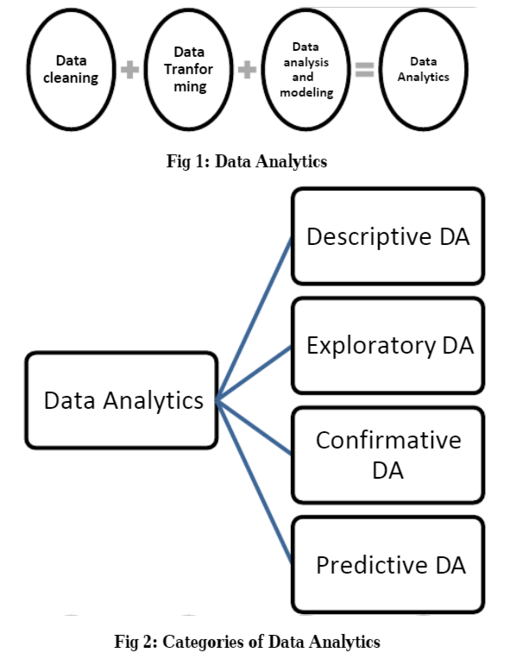
Data Analytics And Its
Categories :

Slide 11
Dataset Description :
As we know the large no. of passengers & crew around 2224 were there in the liner and many didn’t survive. We have took dataset from seaborn library which is named as 'titanic' which have 891 observations and 15 attributes. In this some attributes are repeated.
survived: Outcome of survival (0 = No; 1 = Yes)
pclass: Socio-economic class (1 = Upper class; 2 = Middle class; 3 = Lower class)
sex: Sex of the passenger
age: Age of the passenger (Some entries contain NaN)
sibsp: Number of siblings and spouses of the passenger aboard
parch: Number of parents and children of the passenger aboard
ticket: Ticket number of the passenger
fare: Fare paid by the passenger
cabin: Cabin number of the passenger (Some entries contain NaN)
embarked: Port of embarkation of the passenger (C = Cherbourg; Q = Queenstown; S = Southampton)

Slide 12
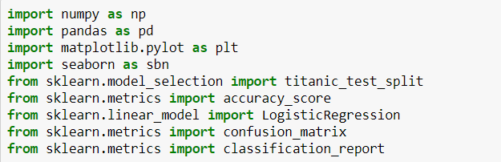
Importing the necessary libraries :

Slide 13
Preprocessing of data
Data Preprocessing is a data mining technique that involves transforming raw data into an understandable format.
Real-world data is often incomplete, inconsistent, and/or lacking in certain behaviour or trends, and is likely to contain many errors.
So in this, we have perform data wrangling, removing
unnecessary attributes, filling null values etc..

Slide 14
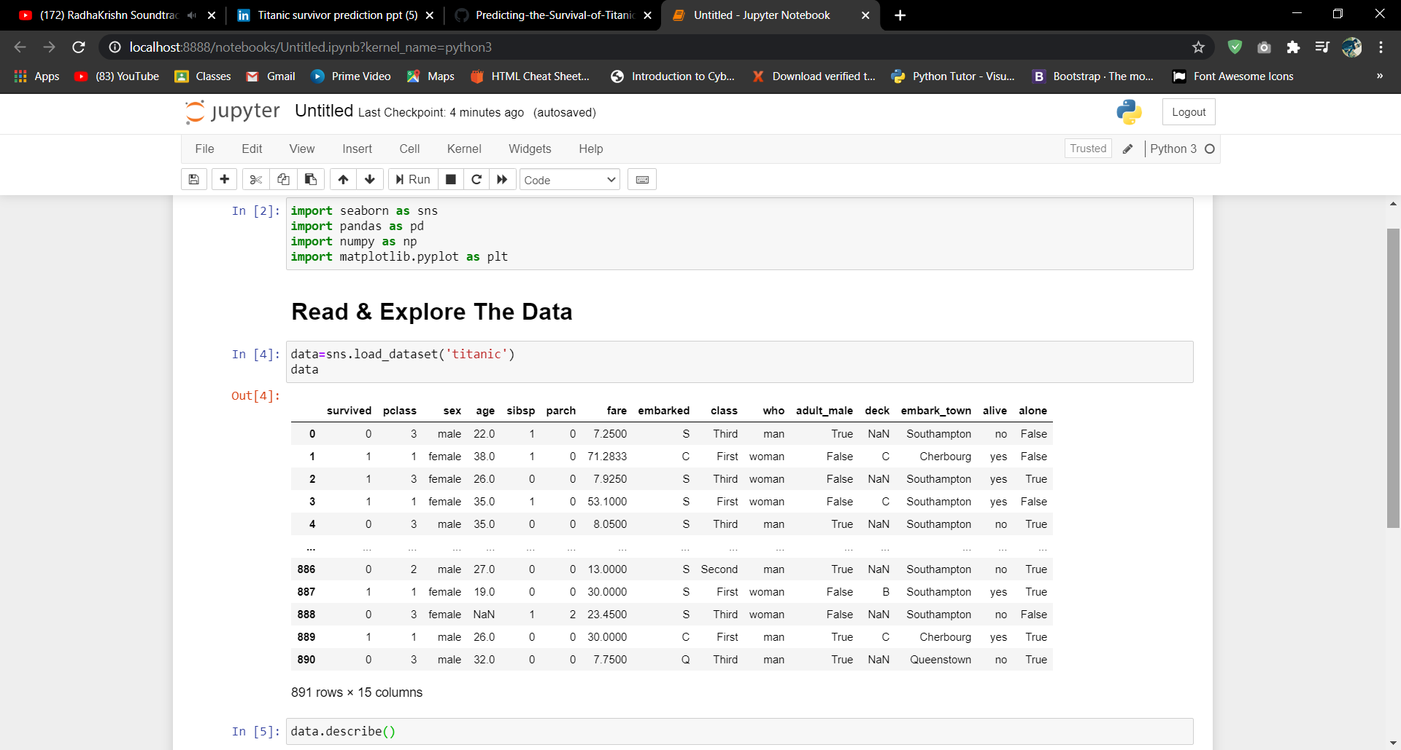
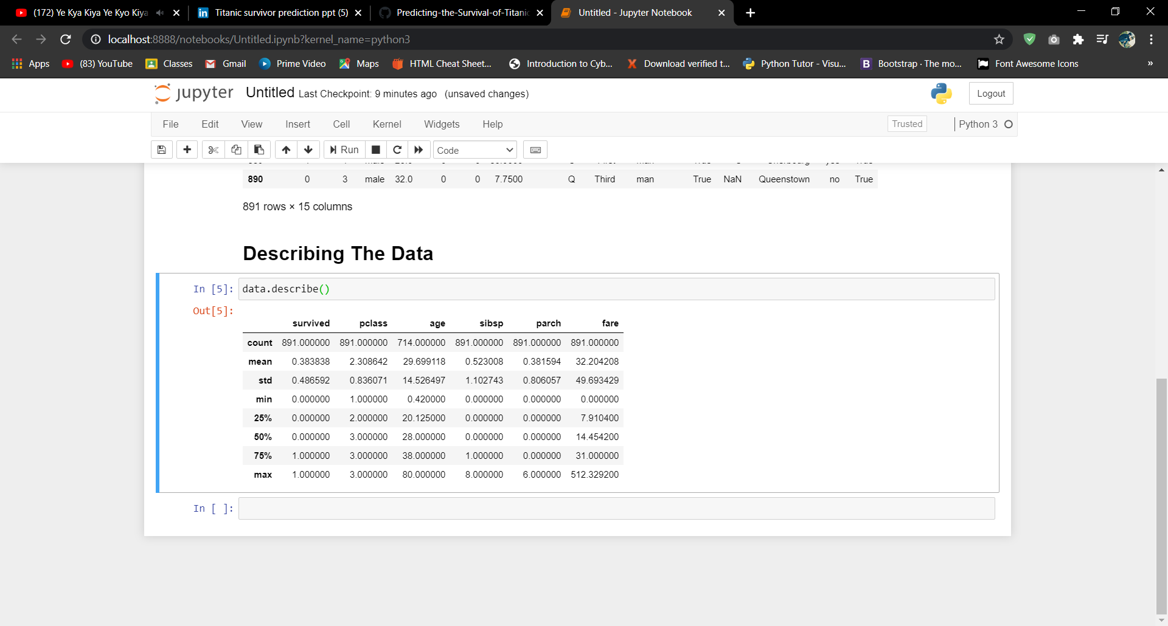

Slide 15
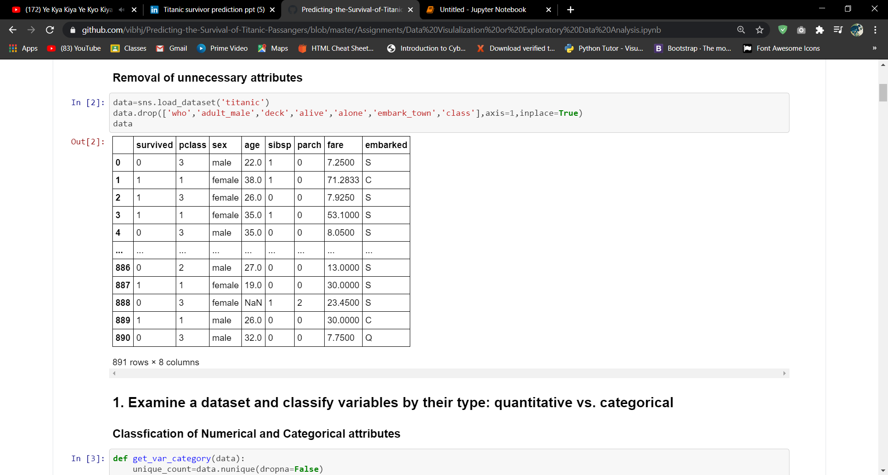
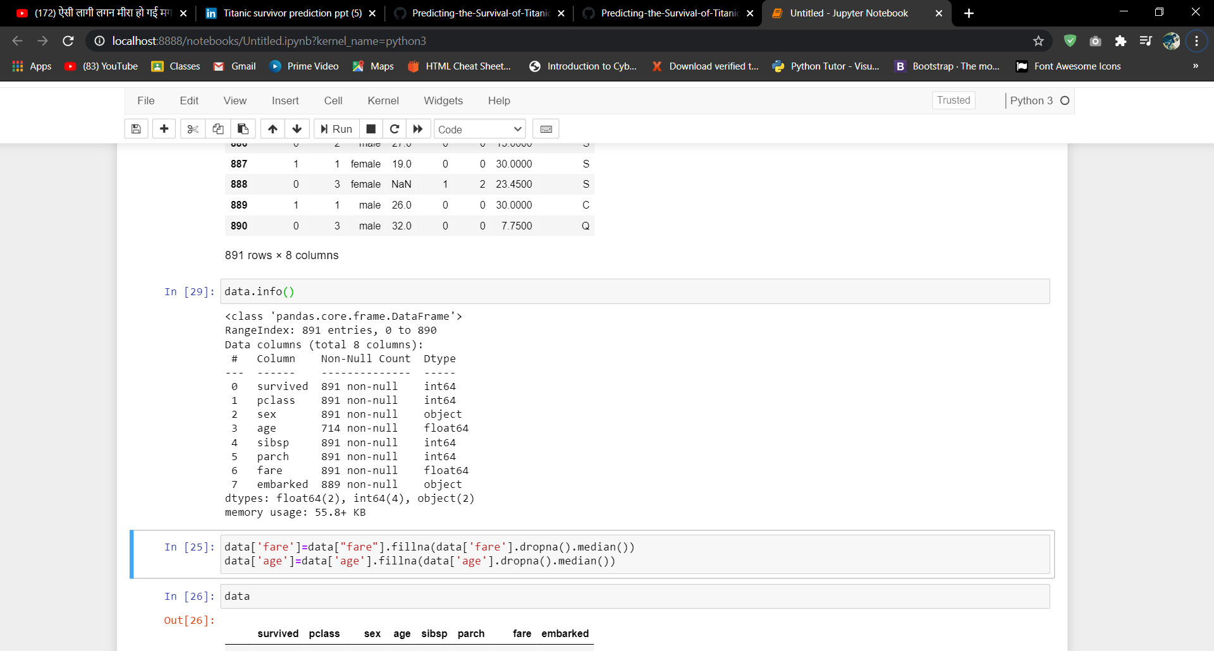
Removal of Unnecessary Attributes

Slide 16
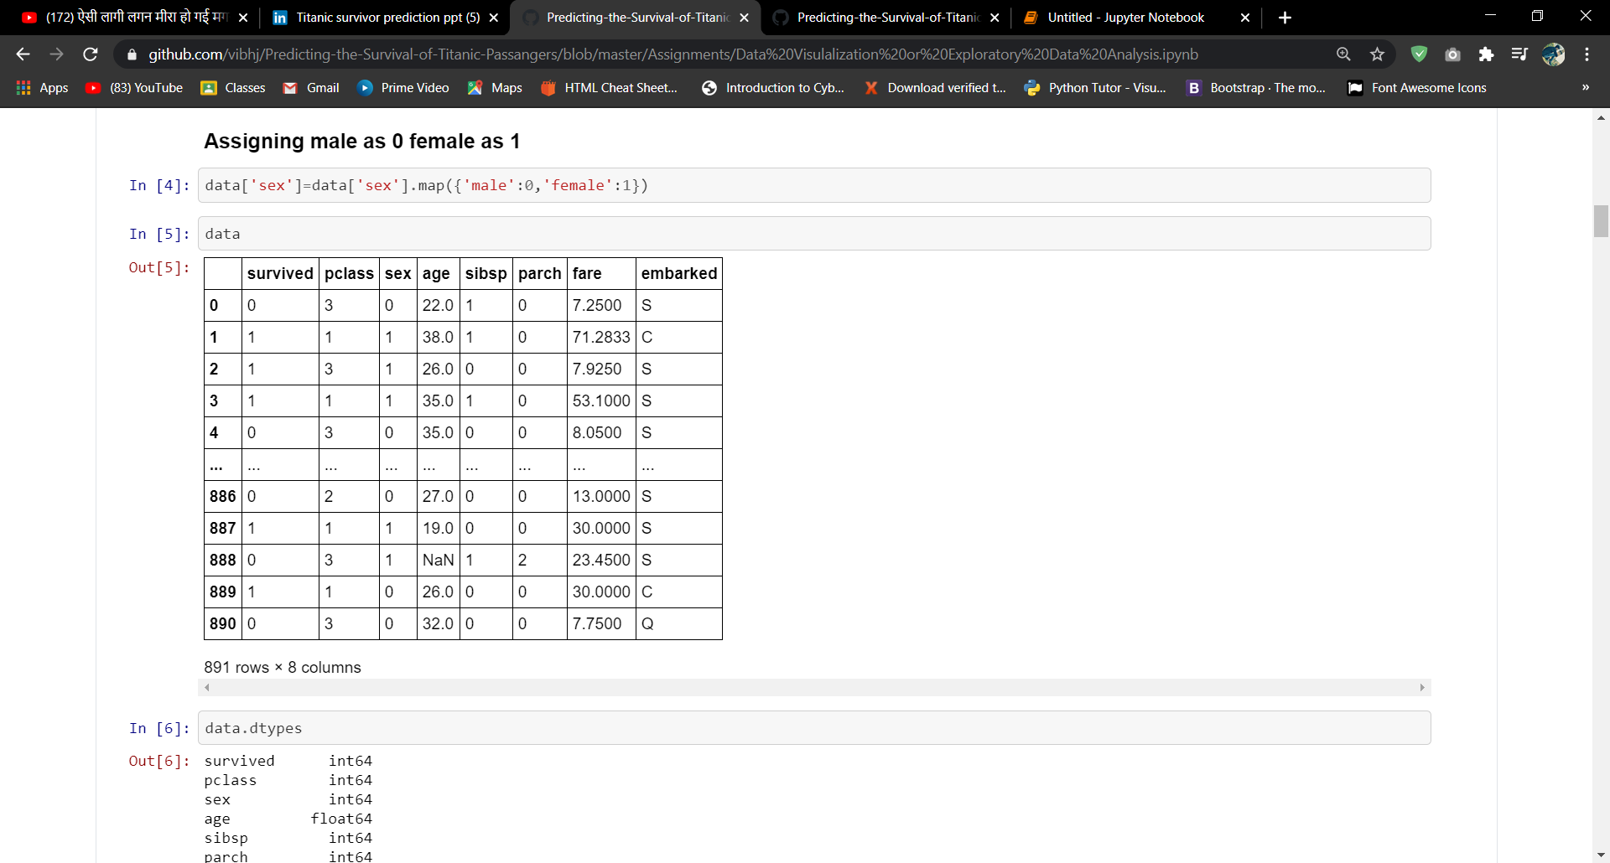
Assigning Male as 0 & Female as 1

Slide 17
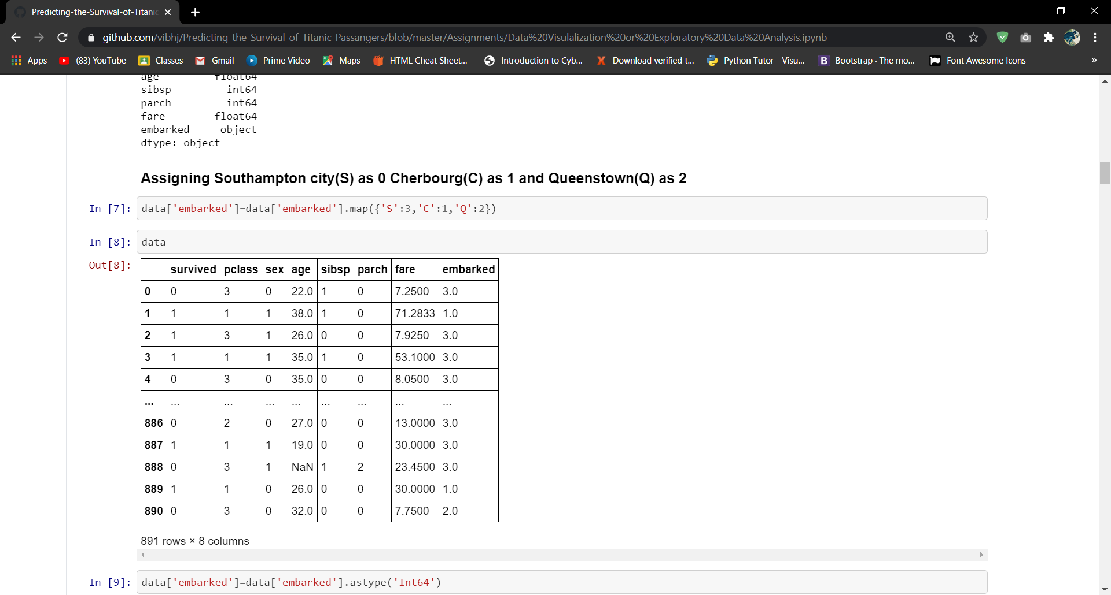
Assigning Southampton city(S) as 3, Cherbourg(C) as 1 and Queenstown(Q) as 2

Slide 18
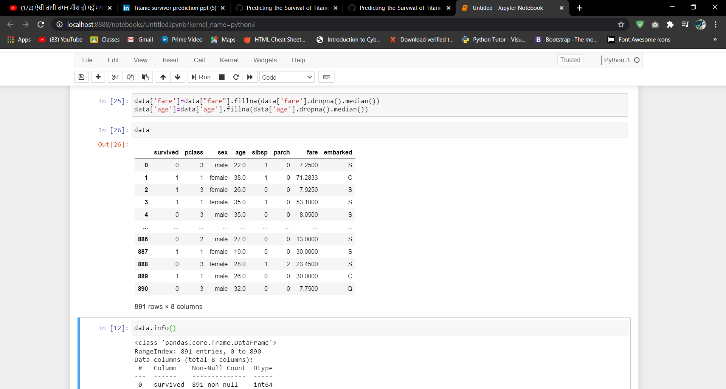
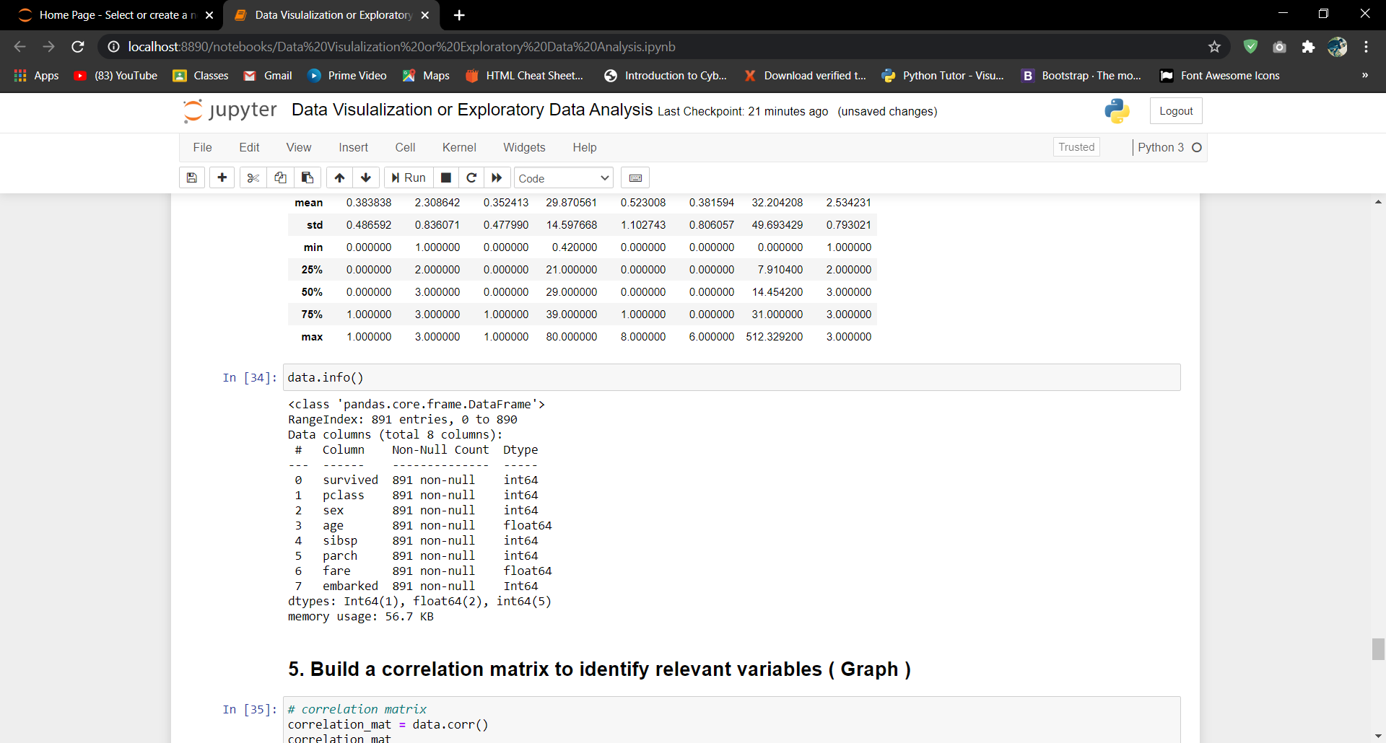
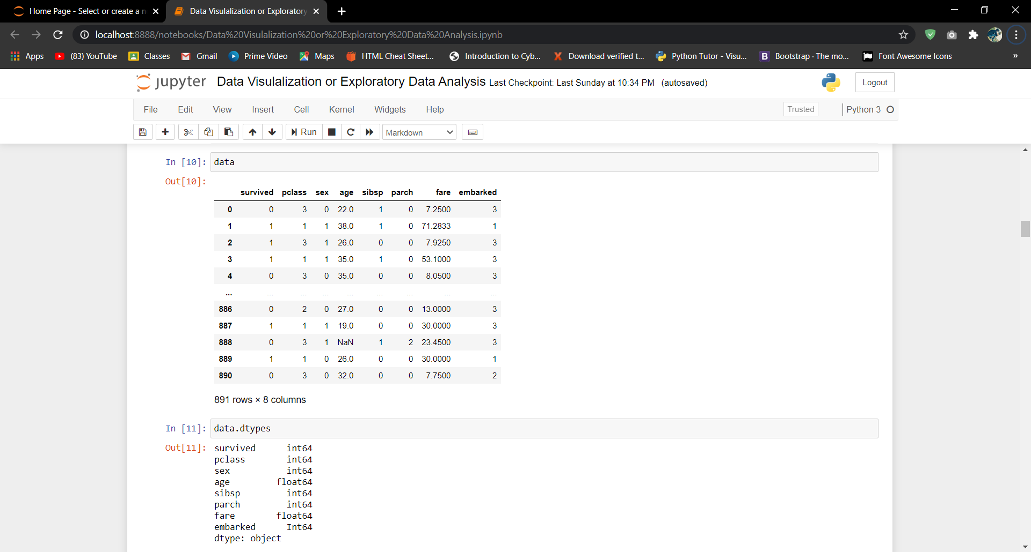
Filling the NaN values with the median of its attributes

Slide 19
Data Visualization
Data visualization is the graphical representation of information and data. By using visual elements like charts, graphs, and maps, data visualization tools provide an accessible way to see and understand trends, outliers, and patterns in data.

Slide 20
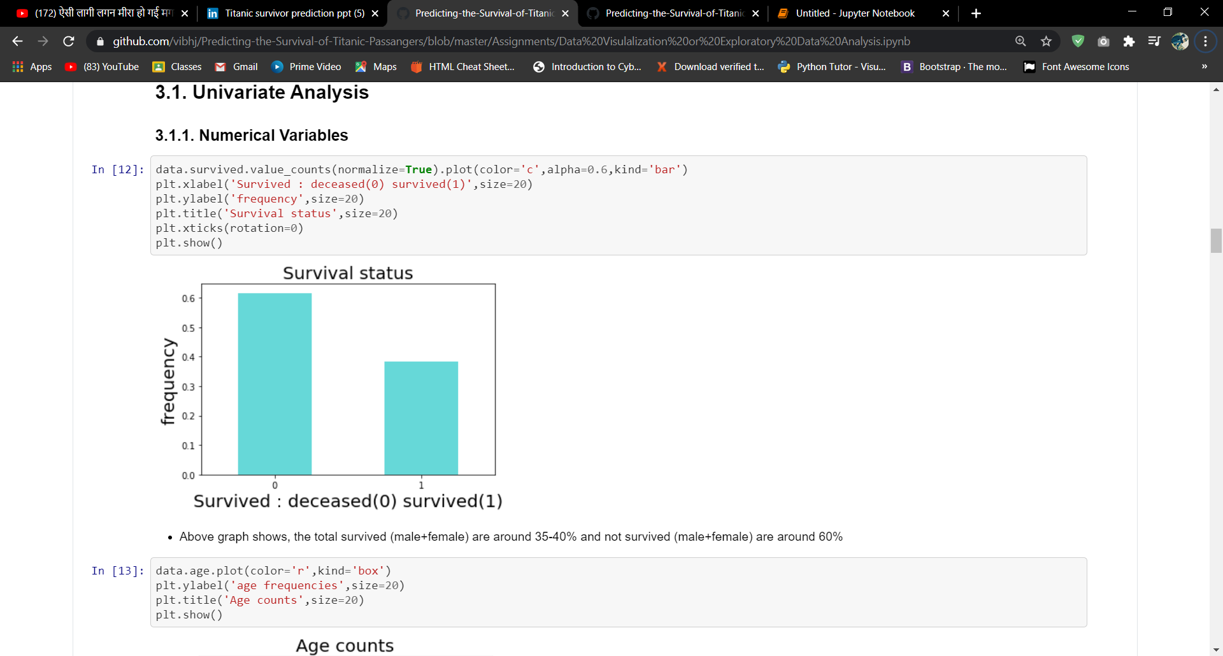
Above graph shows, that the total survived (male + female) are around 35-40% and not survived (male + female) are around 60%

Slide 21
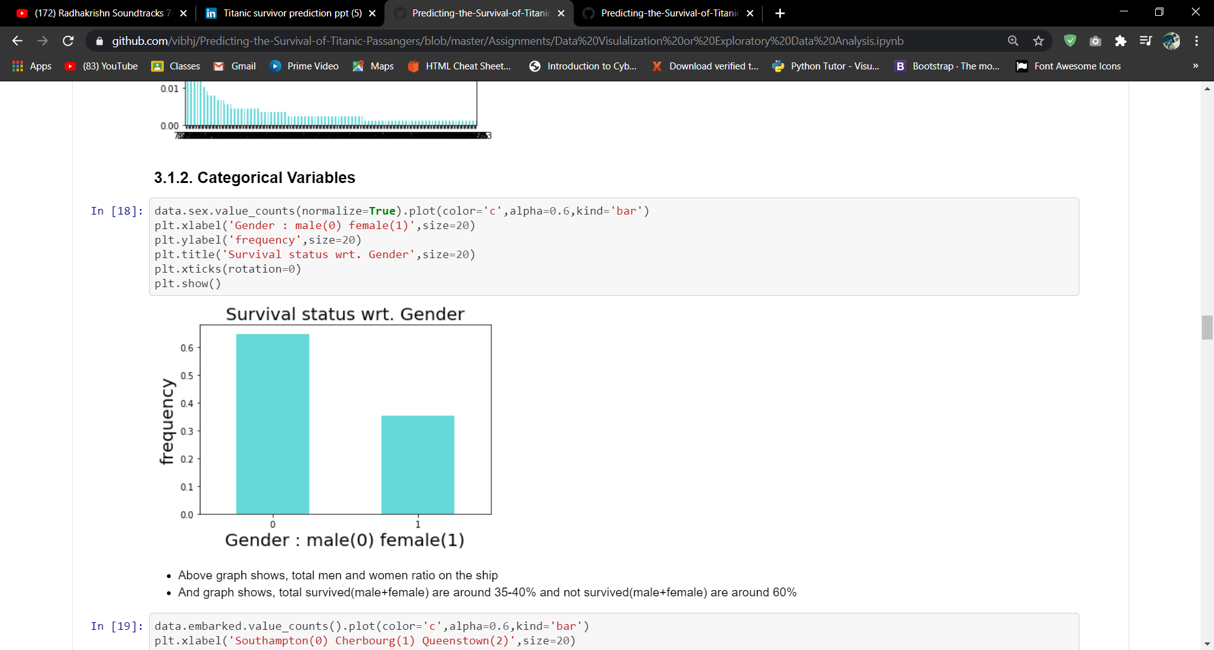
This graph shows, total men and women ratio on the ship and graph shows, total female are around 35-40% and male are around 60% on the ship

Slide 22
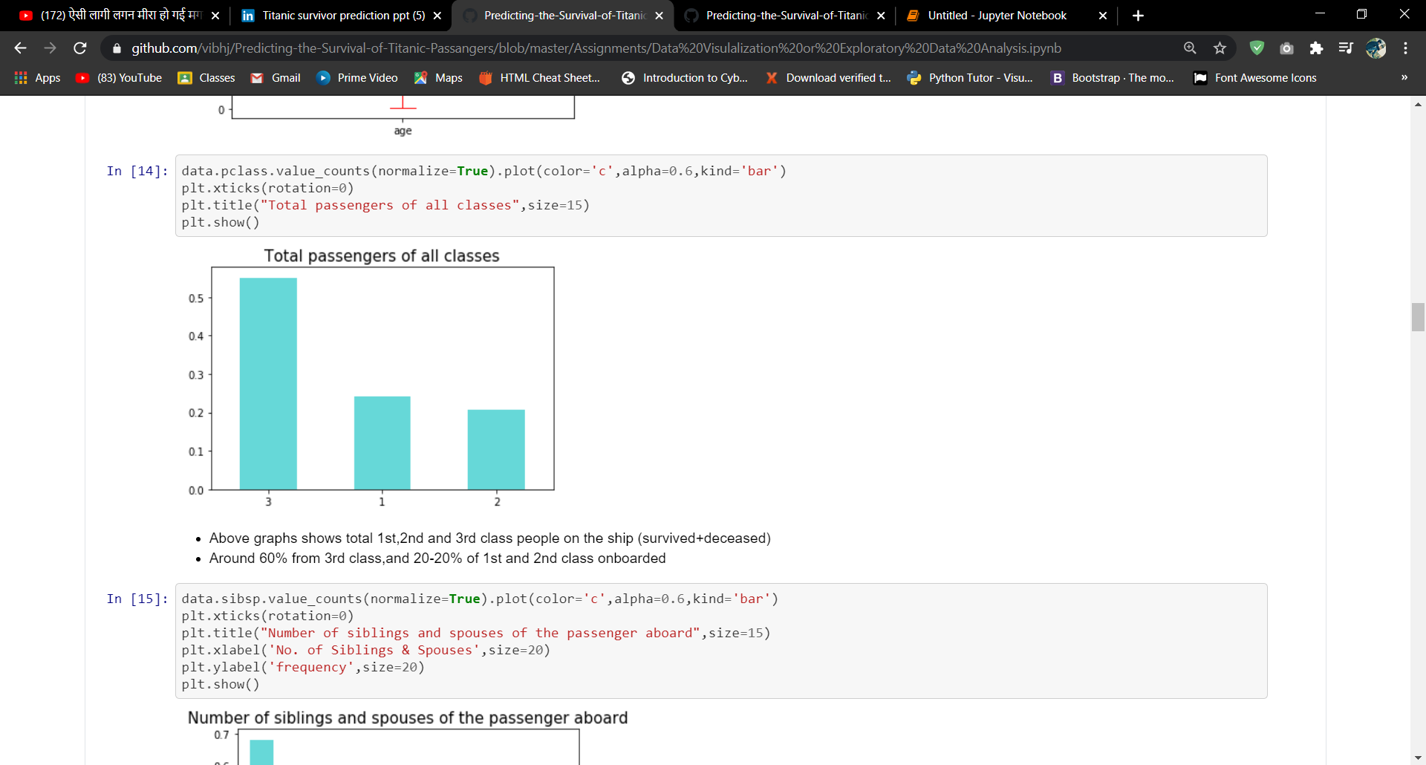
Above graphs shows, total 1st, 2nd and 3rd class people on the ship
(survived + deceased)
Around 60% from 3rd class , and 20-20% of 1st and 2nd class are onboarded

Slide 23
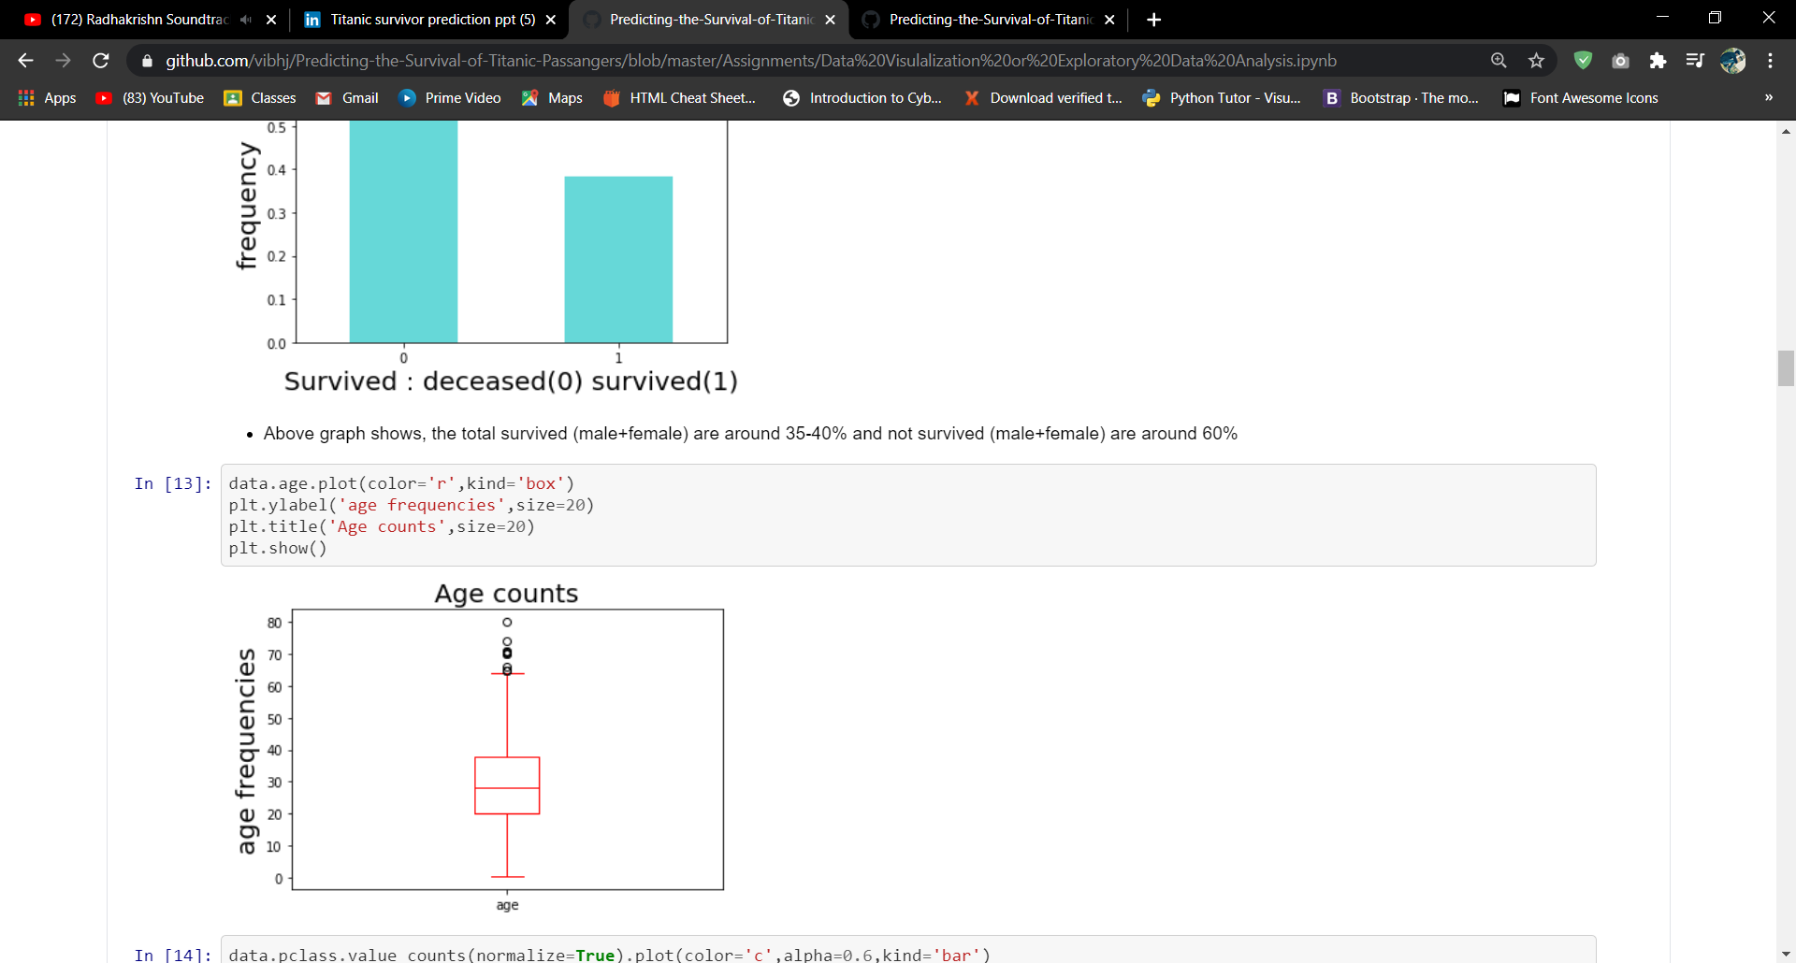
This graph shows, that there is some outliers like a person having age 80 and others

Slide 24
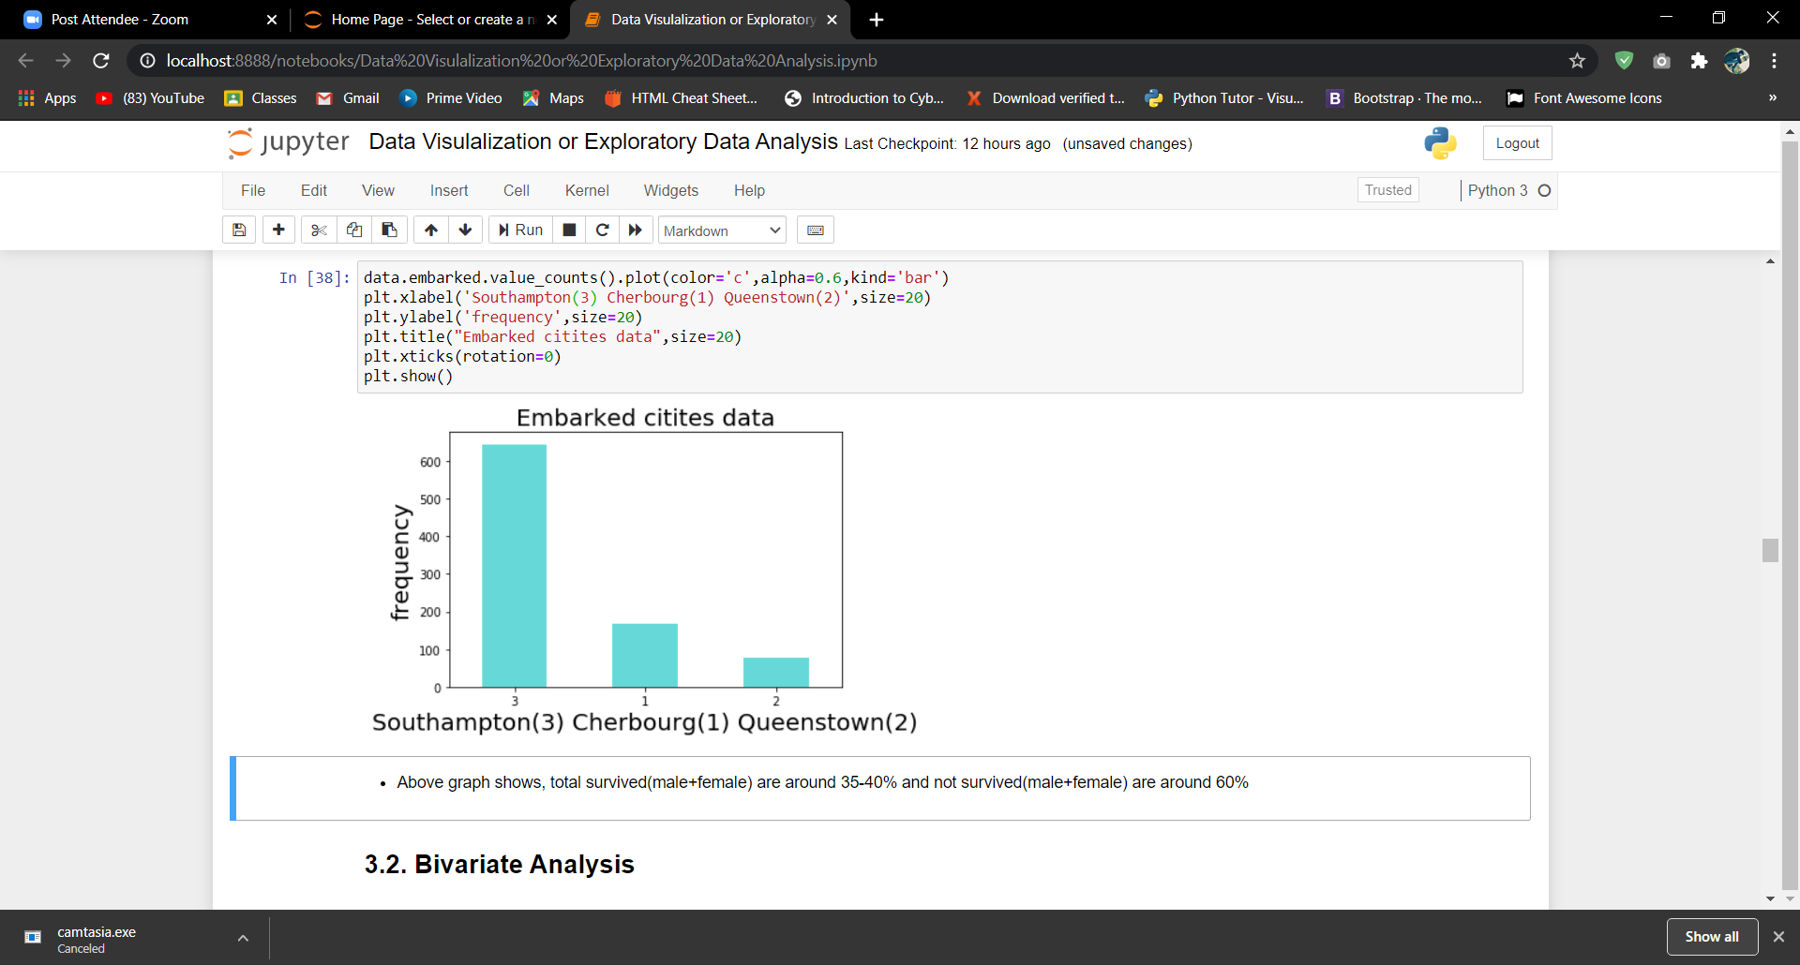
Above graphs shows, 70% passengers embarked from Southampton, 20% from Cherbourg and 10% from Queenstown

Slide 25
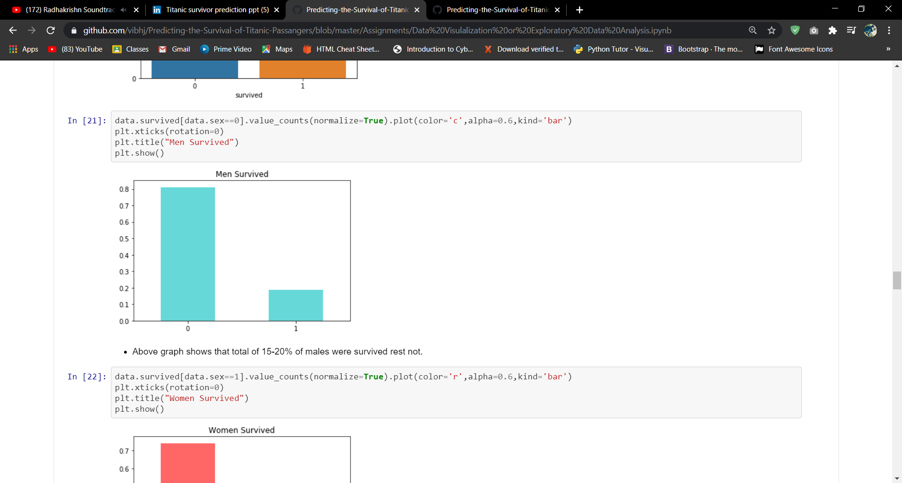
Above graphs shows, that total of 15-20% of males were survived rest not.

Slide 26
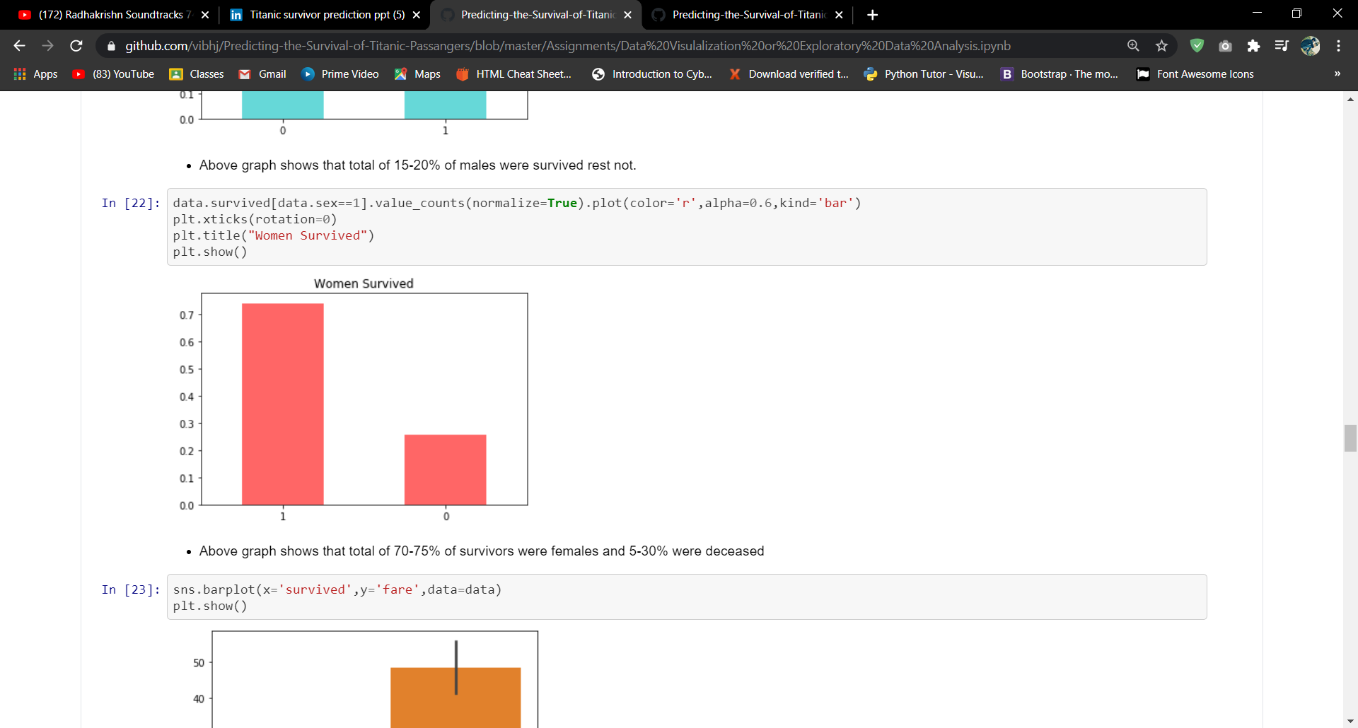
This graph shows, that total of 70-75% of survivors were females and around 30% were deceased

Slide 27
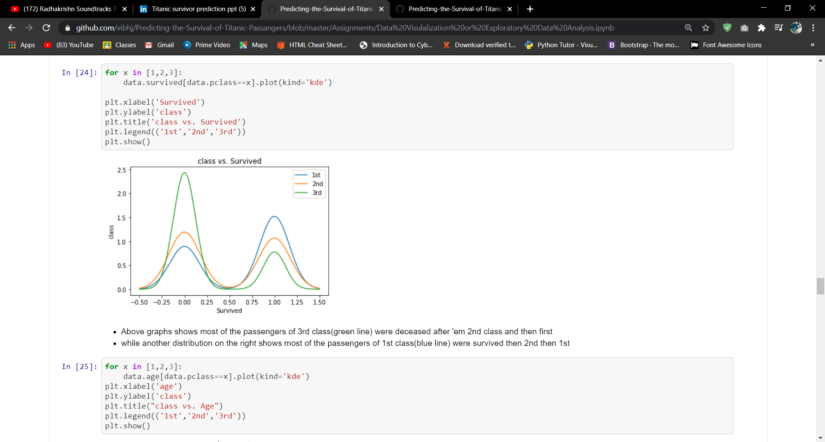
Above graphs shows, that most of the passengers of 3rd class (green line) were deceased after then 2nd class and then first while another distribution on the right shows most of the passengers of 1st class (blue line) were survived then 2nd then 1st

Slide 28
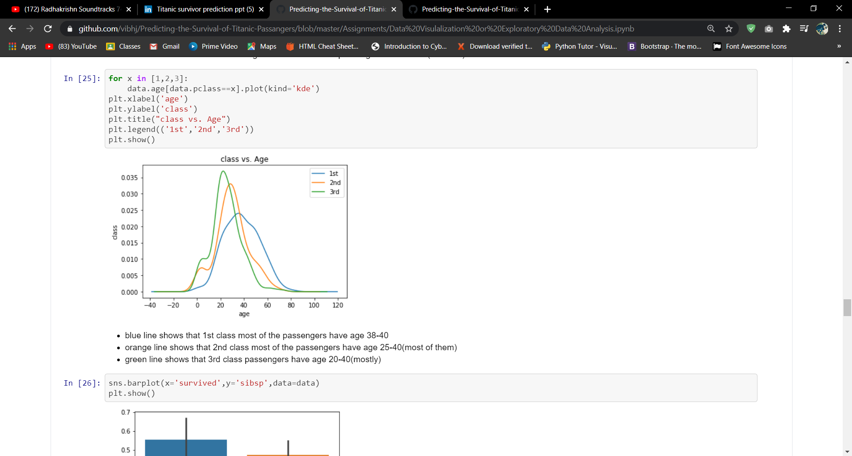
In this graph,
Blue line shows that 1st class most of the passengers have age 38-40
Orange line shows that 2nd class most of the passengers have age 25-40(most of them)
Green line shows that 3rd class passengers have age 20-40(mostly)

Slide 29
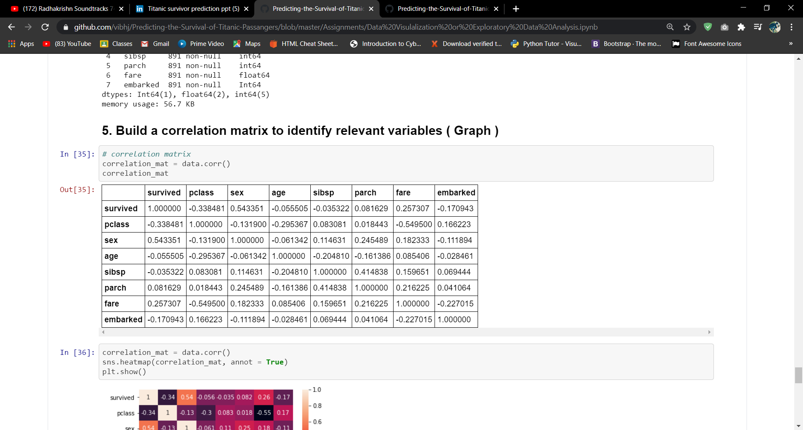
Correlation matrix to identify relevant variables

Slide 30
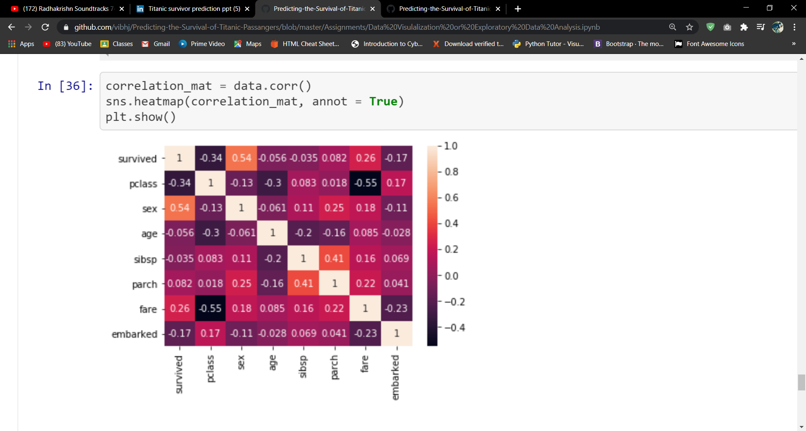
In this graph, heatmap shows dependency between Sex and Survived and the correlation value is 0.54. and we can also see the overall distribution of every attribute with respect to that of another.

Slide 31
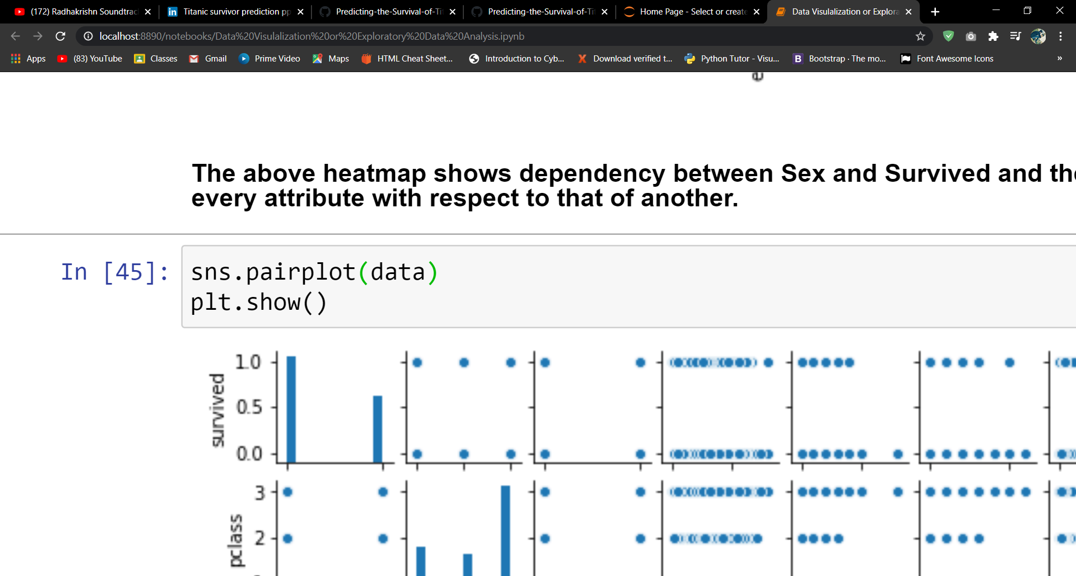
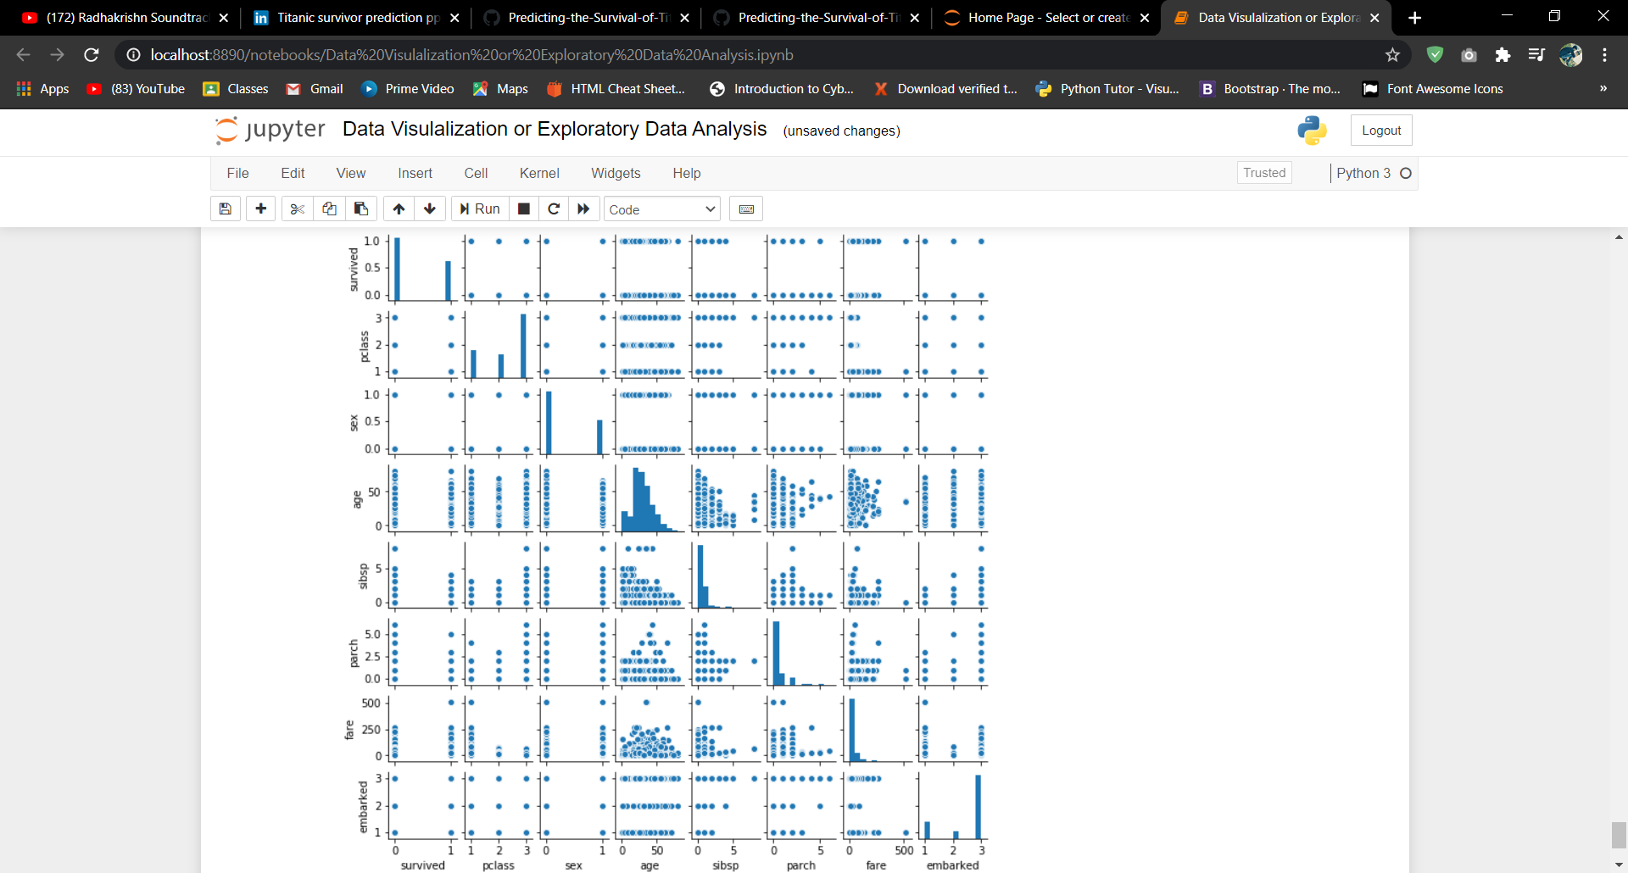
This graph shows, the comparison between all the attributes and its self.

Slide 32

Machine Learning Algorithms
1. Logistic Regression
3. Decision Tree
2. Gaussian Naive Bayes
4. Random Forest

Slide 33
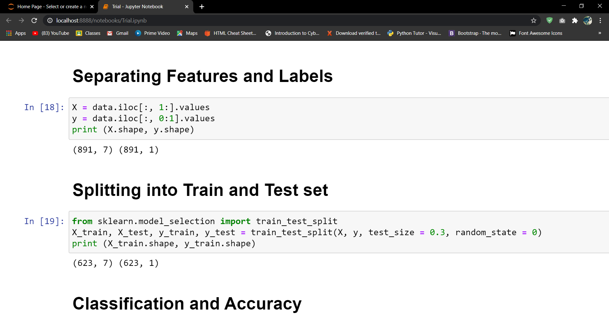

Slide 34
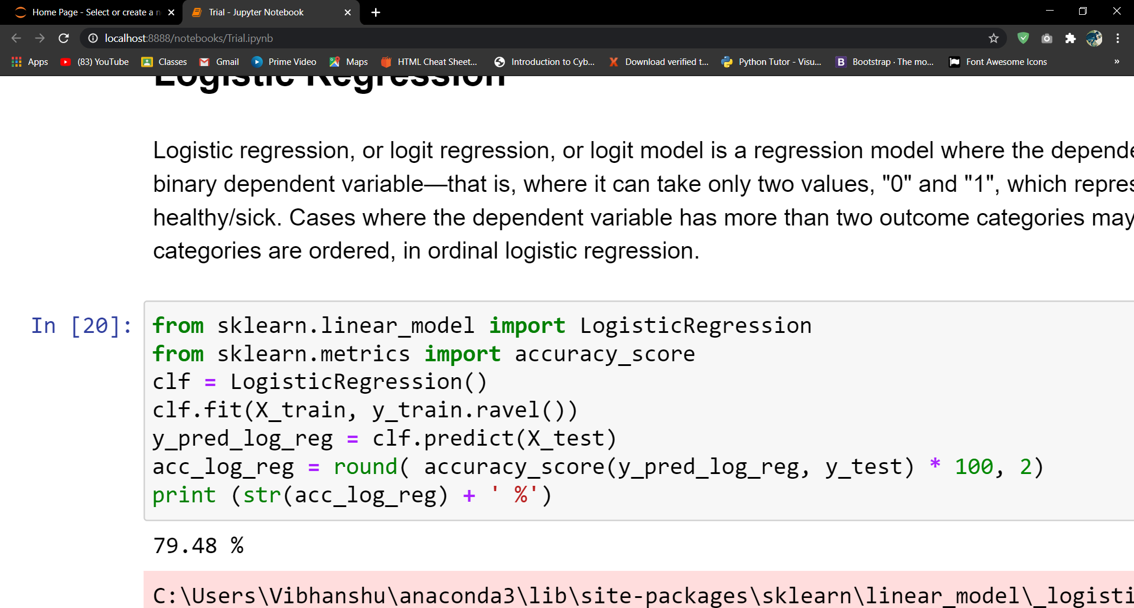
Logistic Regression

Slide 35
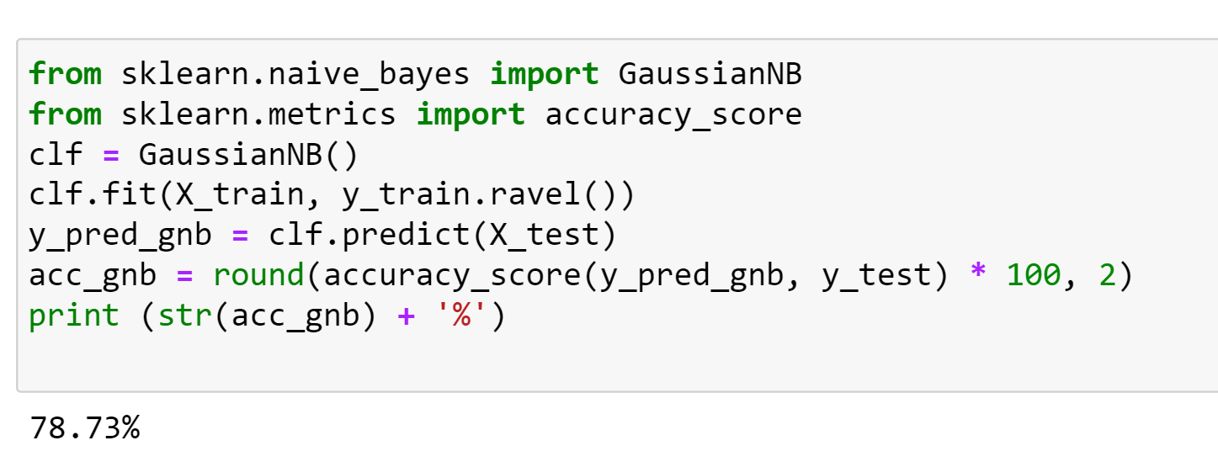
Gaussian Naive Bayes

Slide 36
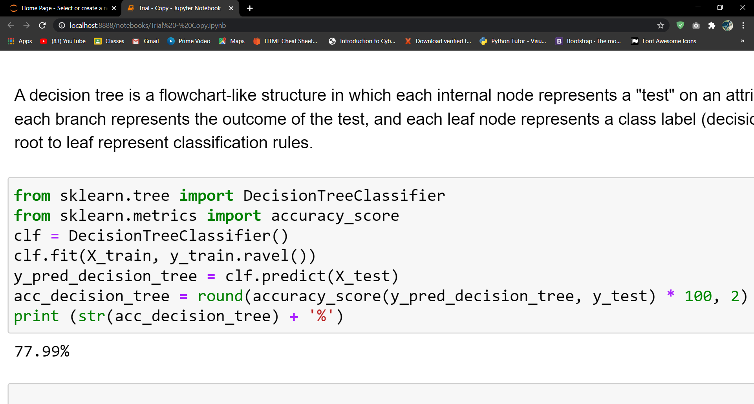
Decision Tree

Slide 37

Random Forest
Random forests or random decision forests are an ensemble learning method for classification, regression and other tasks, that operate by constructing a multitude of decision trees at training time and outputting the class that is the mode of the classes (classification) or mean prediction (regression) of the individual trees. Random decision forests correct for
decision trees’ habit of overfitting to their training set.
Ensemble methods use multiple learning algorithms to obtain better predictive performance than could be obtained from any of the constituent learning algorithms alone.

Slide 38
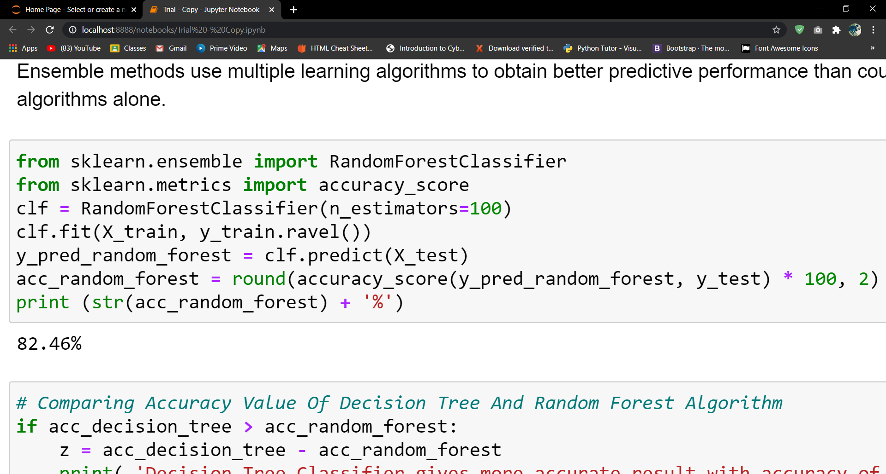
Random Forest

Slide 39

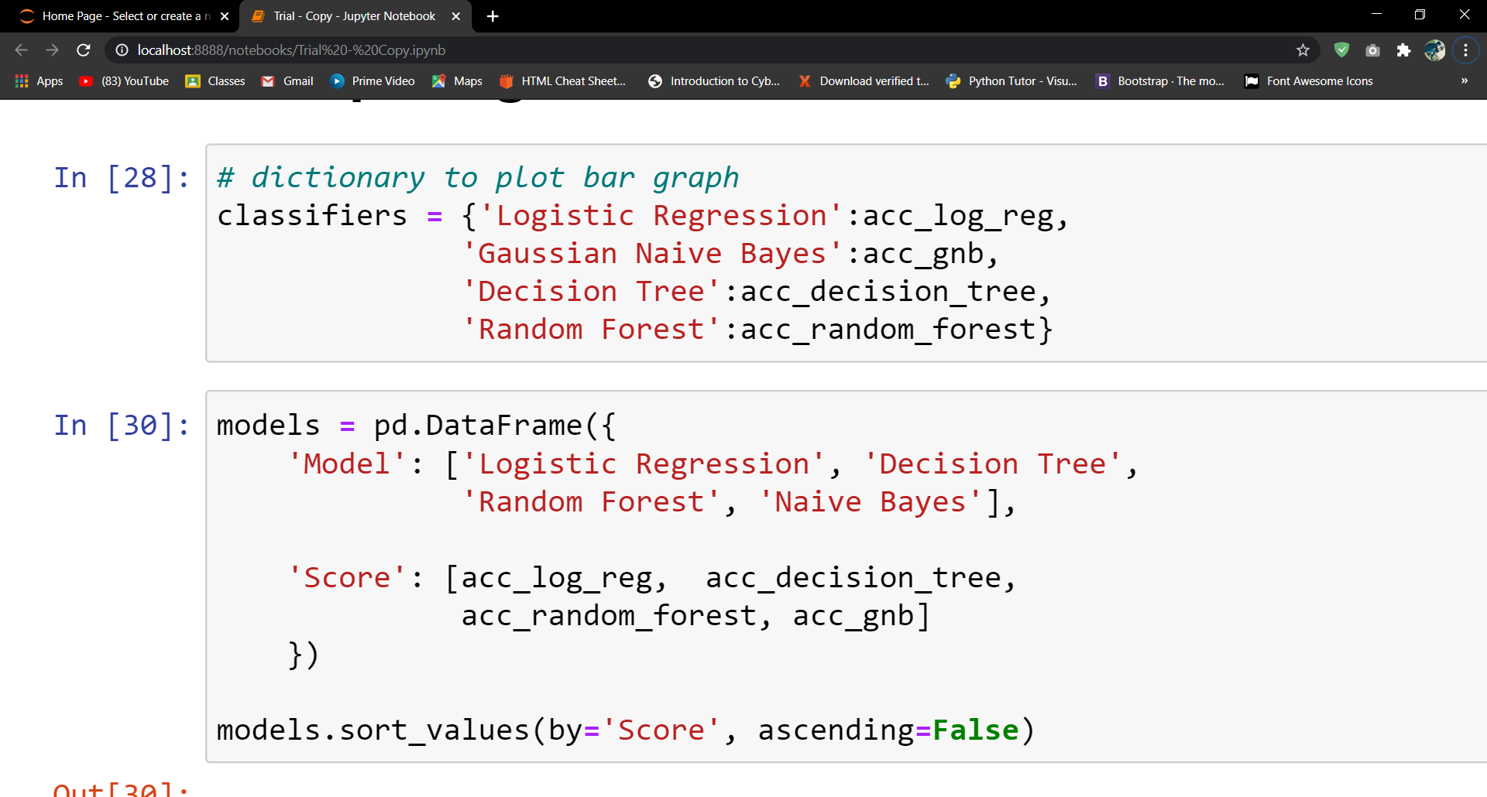
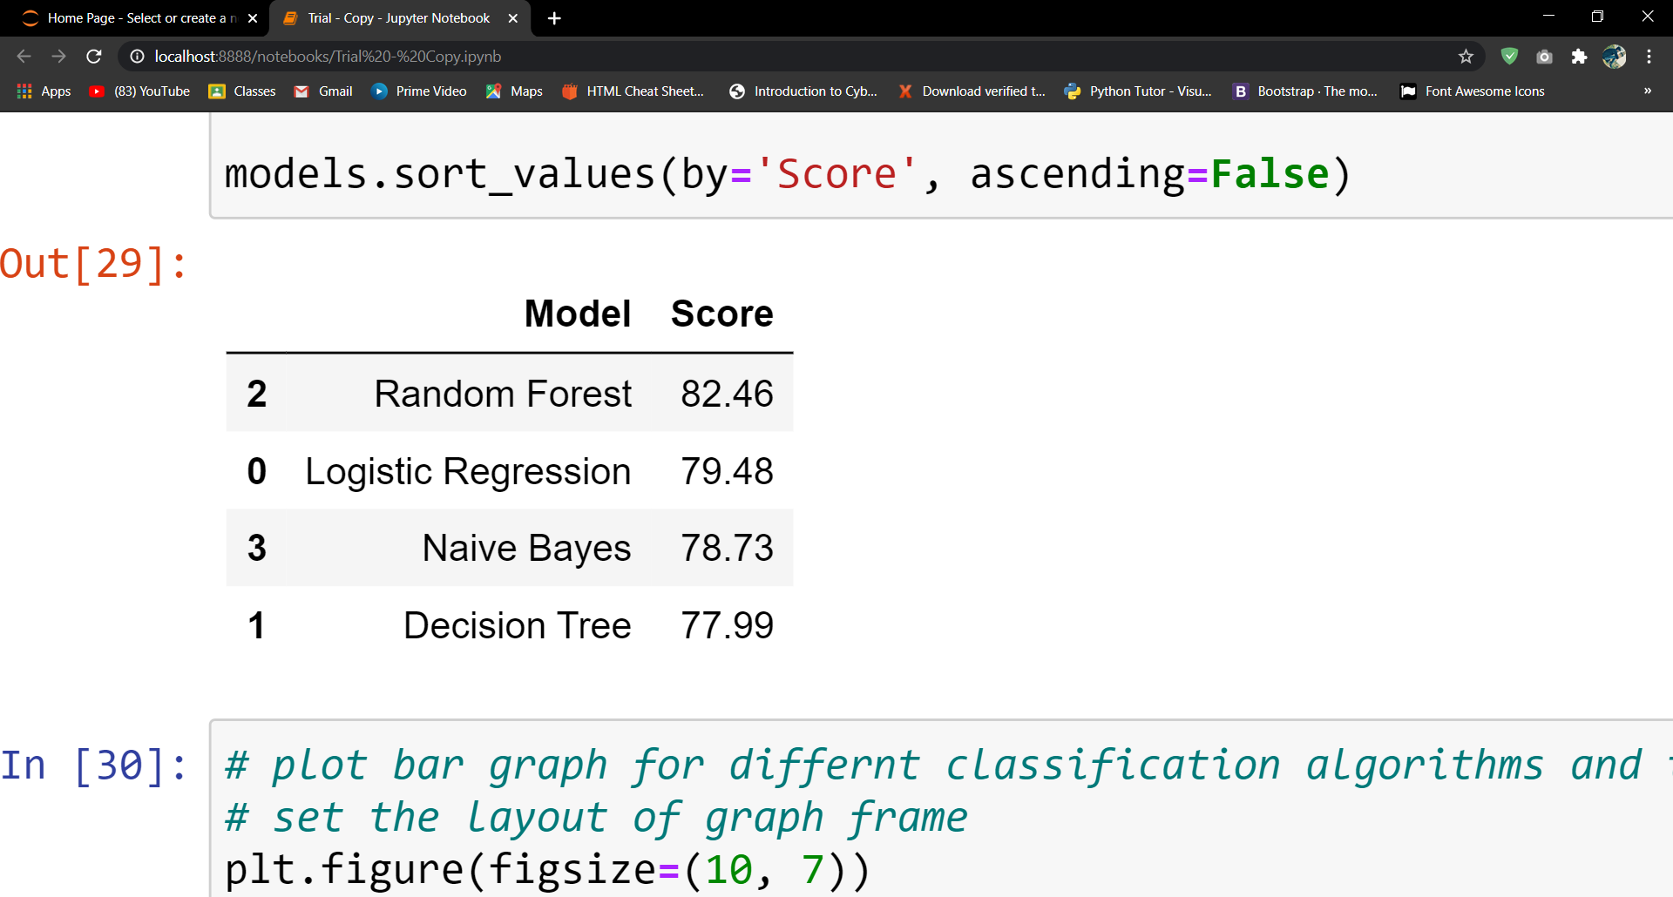
RESULT ANALYSIS
Comparing all the algorithms which we have perform in our dataset

Slide 40
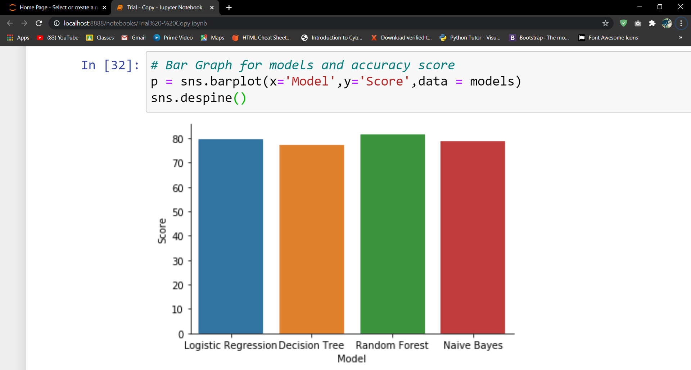
This graph shows, the comparison between all the algorithm which we have perform in our dataset

Slide 41
Conclusion
The analysis revealed interesting patterns across individual-level features. Factors such as socioeconomic status, social norms and family composition appeared to have an impact on likelihood of survival. These conclusions, however, were derived from findings in the given data set.

Slide 42

Thank You!

